Slide 1

DESIGNING MONOLITH FIRST FOR MICROSERVICE ARCHITECTURE
Halil İbrahim Kalkan

Slide 2

Agenda
TODO: ...

Slide 3
INTRODUCTION
DESIGNING MONOLITH FIRST FOR MICROSERVICE ARCHITECTURE

Slide 4

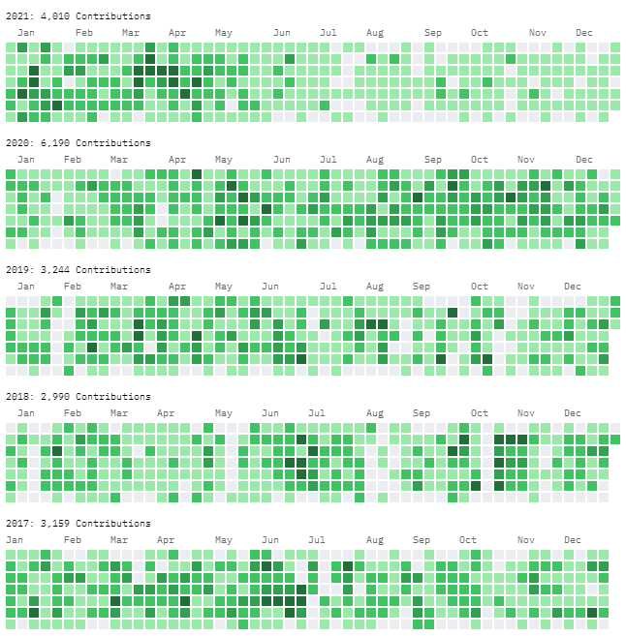
About me: Halil İbrahim Kalkan
halilibrahimkalkan.com
GitHub: hikalkan
Twitter: hibrahimkalkan

Slide 6
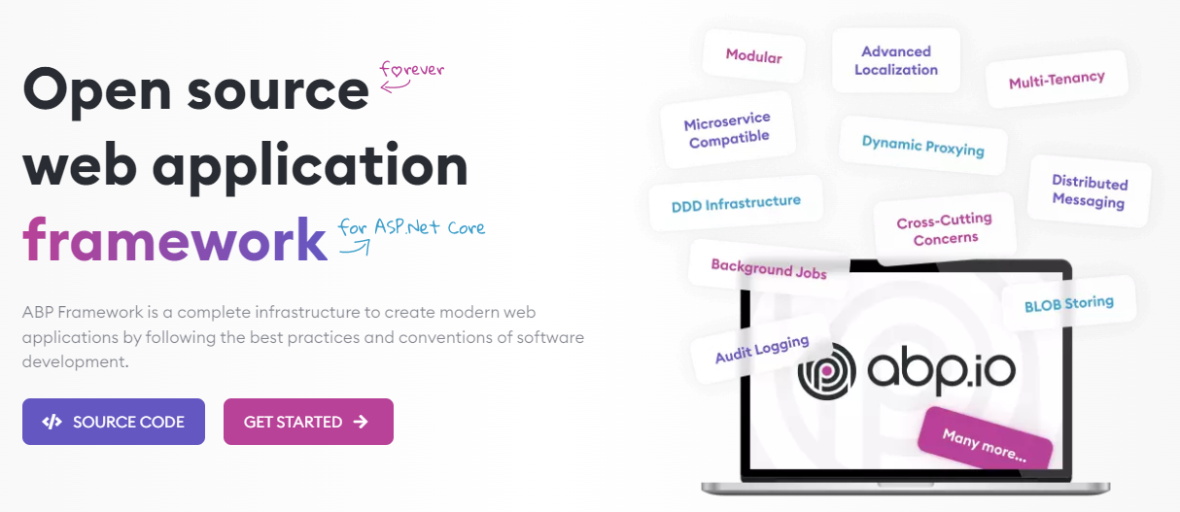
The ABP FRAMEWORK project

Slide 7
ABP Framework: Architecture
Domain Driven Design
& Layered Solution
Modular
Multi-Tenancy (SaaS infrastructure)
Microservice ready

Slide 8
ABP Framework: Infrastructure Enterprise application requirements
Cross-cutting concerns
Authentication & authorization
Distributed event bus
Audit logging
Background jobs
Data filtering & soft-delete
Dynamic client-side proxies
Dynamic forms
…more

Slide 9
ABP Framework: Startup templates

Slide 10
About me
TODO: ...

Slide 11
About me
TODO: ...

Slide 12
About me
TODO: ...

Slide 13
DESIGNING A MODULAR MONOLITH
DESIGNING MONOLITH FIRST FOR MICROSERVICE ARCHITECTURE

Slide 14
About me
TODO: ...

Slide 15
About me
TODO: ...

Slide 16
MIGRATING TO MICROSERVICES
DESIGNING MONOLITH FIRST FOR MICROSERVICE ARCHITECTURE

Slide 17
About me
TODO: ...

Slide 18
About me
TODO: ...

Slide 19
About me
TODO: ...

Slide 20
About me
TODO: ...

Slide 21
About me
TODO: ...

Slide 22
About me
TODO: ...

Slide 23
About me
TODO: ...

